Slide 1
Senario: AI-Powered Expert Advisor
Innovative Business Solutions with Large Language Models (LLMs)
Asuka Ikemoto

Slide 2
Product Definition

Slide 3
Your Customer
Who are you serving?
Target user
Field Technician
Demographic and behavioral characteristics
Age: 20-60
Education:
85% High school
35% Community college
Languages
English, Spanish, Cantonese, Mandarin, Urdu
Devices
95% Mobile
75% Computer
25% Tablet

Slide 4
The Problem
What user need are you addressing?
What is the user trying to do? | How do they currently do it? | What are the biggest problems with the current approach?
To understand the meaning of machine errors and respond quickly | Knowledge base search Paper manuals Ask supervisor or colleagues | Searching is slow Language and terminology is difficult Source of truth is unclear
To check the procedures | Knowledge base search Paper manuals Ask supervisor or colleagues | Procedures are outdated Hard to view on a smartphone Unclear safety

Slide 5
The Solution
How will you solve it?
What It Does
Immediate answers to field technicians' questions in natural language using LLM
Conversational support for interpreting error codes, presenting procedures, safety checks
Multilingual and mobile support
What It Replaces / Requires
Replaces: Knowledge base search, paper manuals
Requires: Restructuring knowledge base, preparing the documents in multiple languages
Privacy & Connectivity
Design not to contain PII
Utilized the factory wifi with API connections
Why LLM?
Understands flexible expression of input and considers context
Great summarization in one interaction
Easy to deal with differences in specifications and local terminology

Slide 6
Risks
What could go wrong?
Product Risk and Mitigation Strategies
Risk | Mitigation
Encourage the dangerous procedure | Force insertion of the template for the safety procedures Add reconfirmation flow for high-risk operations with other colleagues, supervisors
Unclear, unrealistic response | Place LLM syntax rules following the answer templates Update the escalation workflow

Slide 7
System Details

Slide 8
System Attributes
What must your product do?
Primary product benefit
Give field technicians fast, reliable response in their own languages
Secondary Benefits
Reduce unnecessary escalations
Enhance confidence in decision making among less experienced workers

Slide 9
System Architecture
What type of AI system are you building?
Overview
Build an AI-Powered Expert Advisor that integrates structures robot data, multilingual support, and user context, will delivered via a conversational interface
Key Components
UI: Multilingual chat interface, language auto detection (text + voice)
LLM Engine: Core of natural language reasoning, enhanced with custom prompt engineering, RAG
Knowledge Source: 7,500 KB articles, parts DB, robot configuration DB(real-time via API), troubleshooting logs, SOPs
Context Layer: Inject user device type, robot model, error checking, local setting into prompts

Slide 10
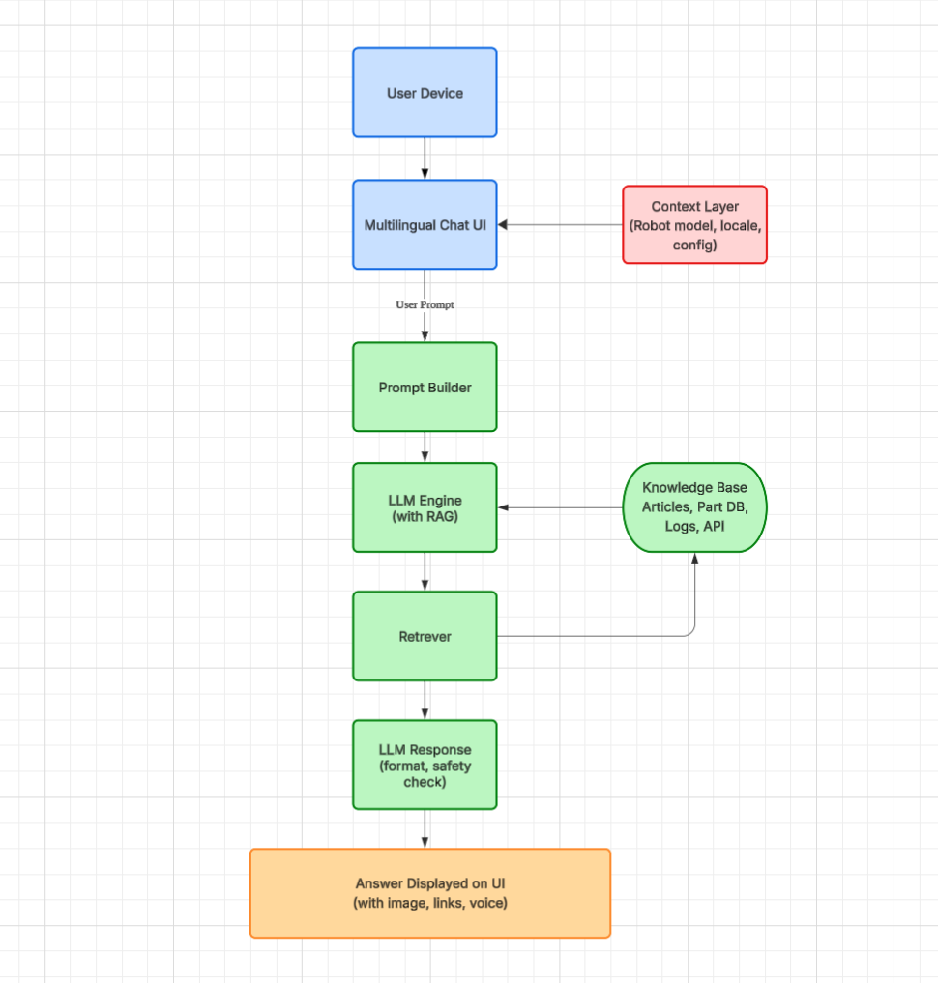
System Architecture
What type of AI system are you building?
Data Flow

Slide 11
LLM Configuration
Which properties and settings do you recommend?
Property | Value | Rationale
License type | Open-source | Flexibility in deployment, cost control, and potential for fine-tuning
Deployment type | Private cloud | Ensures data privacy and regulatory compliance
Setting | Value | Rationale
Temperature | 0.2 – 0.4 | Factual and consistent response
Top K | 20 | Control sampling diversity while maintaining relevance

Slide 12
Measurement

Slide 13
Metrics
How will you know your product is successful?
Metric | Ideal value | Purpose
Average response time | < 3 seconds | Ensure system is usable in fast-paced environment
Escalation rate | < 10% | Reduce workloads on support staff while ensuring the safety
Unsafe output rate | < 0.1% | Monitor LLM hallucinations, harmful output

